Slide 1
#ReMap Prospecting for Renewables with Machine Learning
George Richardson
Rachel White
Laura Hinkelman
Sam Hooper
Julia King
With a lot of help from:
Catherine Kuhn
Google Earth Engine Users
Geohackweek 2016
University of Washington eScience Institute

Slide 2

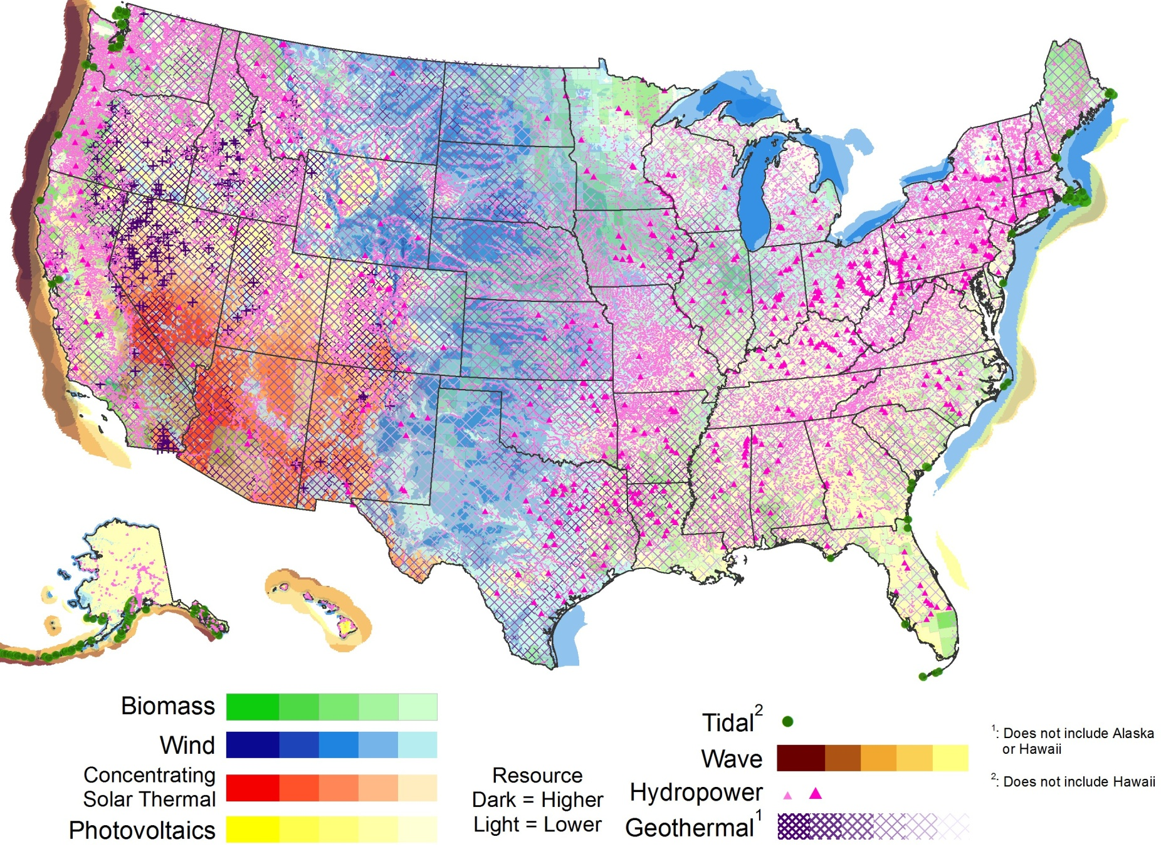
The Challenge
Remotely identifying sites for renewable energy by type
f(x) =

Slide 3
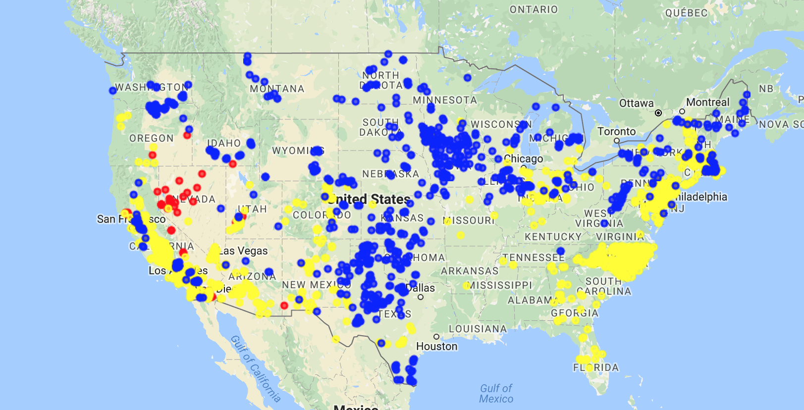

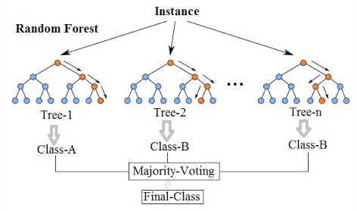
Methodology
?
Classifier

Slide 4
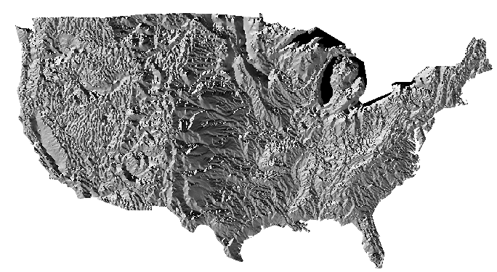
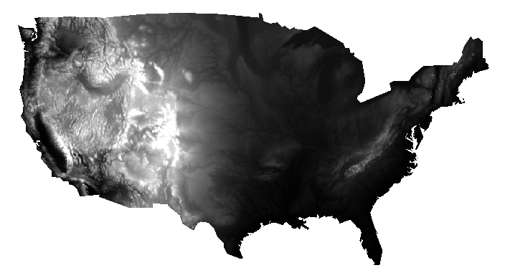
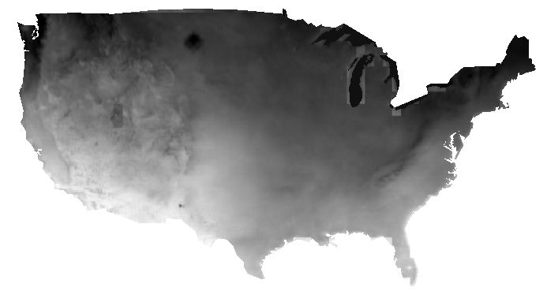
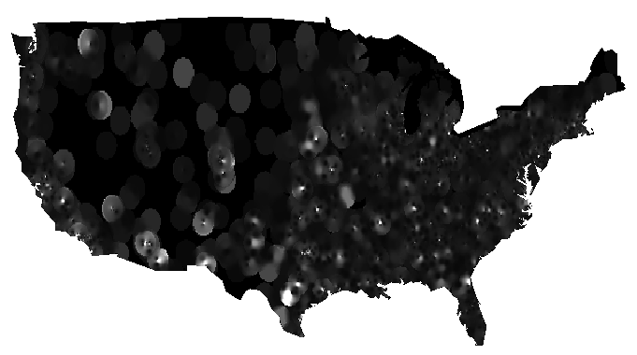
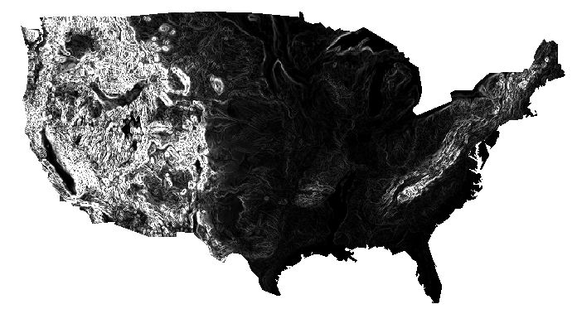
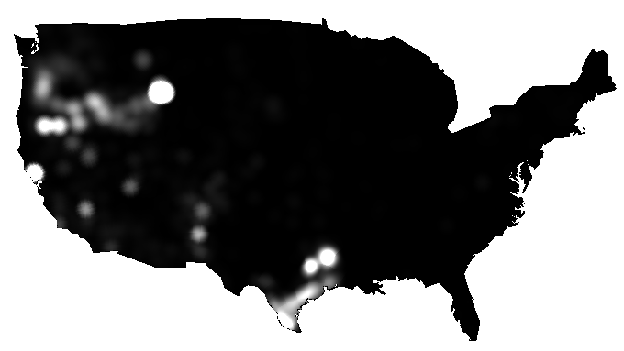
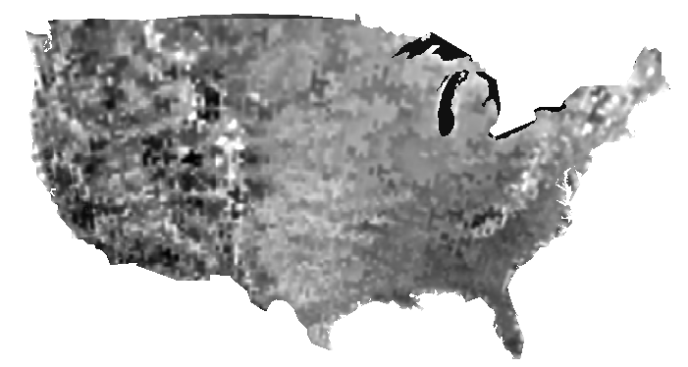
Predictors
Aspect
Elevation
Irradiance
Pop. Density
Slope
Geothermal Gradient
Wind Speed

